Slide 1

REAL-TIME HUMAN DETECTION & COUNTING

Slide 2
MEMBERS
Name
Divyansh Srivastava
Shivam Kumar
Shivansh Singhal
Ashhad Khalil Farooqi
Hansraj Singh

Slide 3
INTRODUCTION
A real life application of human object detection model.
Use of Image Processing, Video Processing, Object Detection and Deep neural networks are used which are rigorous parts of modern Artificial Intelligence.
The project will focus on human object detection and count of people in an image or in a real time video through camera or some other source.
We’ve worked on three different methods and algorithms to detect a human object in order of their increasing accuracy.

Slide 4
FURTHER IMPROVEMENT
Further we have improved some user interfaces and added some additional features.
Used additional libraries like
Imutils - a series of convenience functions to make basic image processing functions such as translation, rotation, resizing, skeletonization, and displaying Matplotlib images easier with OpenCV and Python.
Argparse – this module makes it easy to write user-friendly command-line interfaces.
Also worked on the labelling of the human body detected by the program by the counter which tells us the count of the number of people at that particular instance in the video.

Slide 5
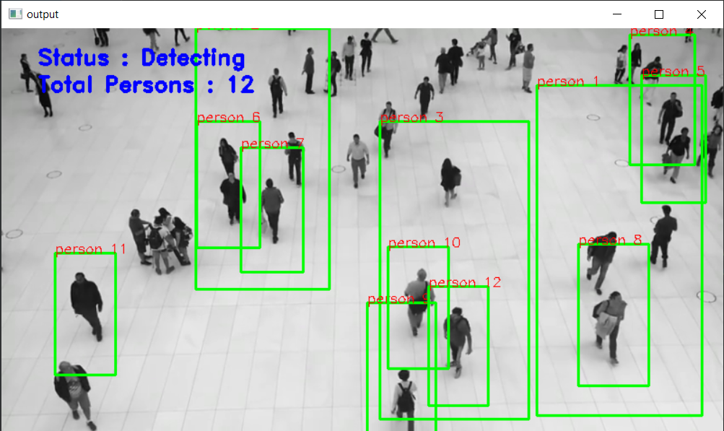
FURTHER IMPROVEMENT
Executed the program and got the output as below with more accuracy on numbers detected and got the labelling also.

Slide 6
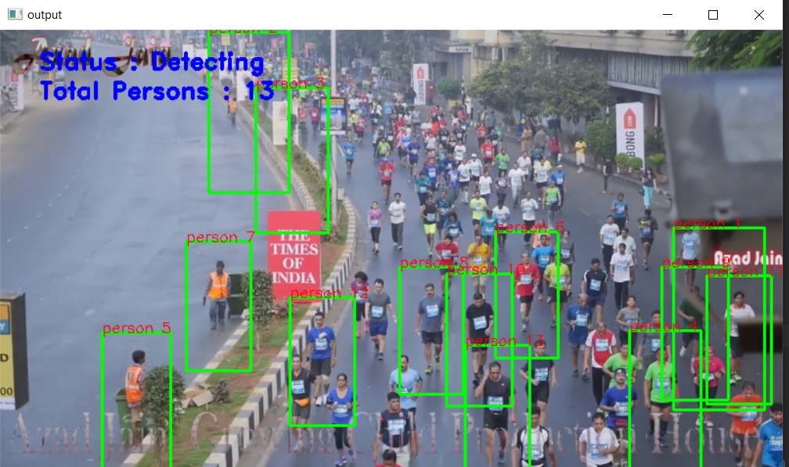
SAMPLE OUTPUT

Slide 7
GUI
Added frontend part in the project. For this we used Tkinter GUI and added different buttons and labels.
Additional Libraries used:
Tkinter – for frontend GUI window
PIL – for adding images to the tkinter GUI window
Messagebox from tkinter – to show any message using dialog box
Filedialog – to select images and video using select buttons.
When we run the code, a GUI window will open with START and EXIT button on it.

Slide 8
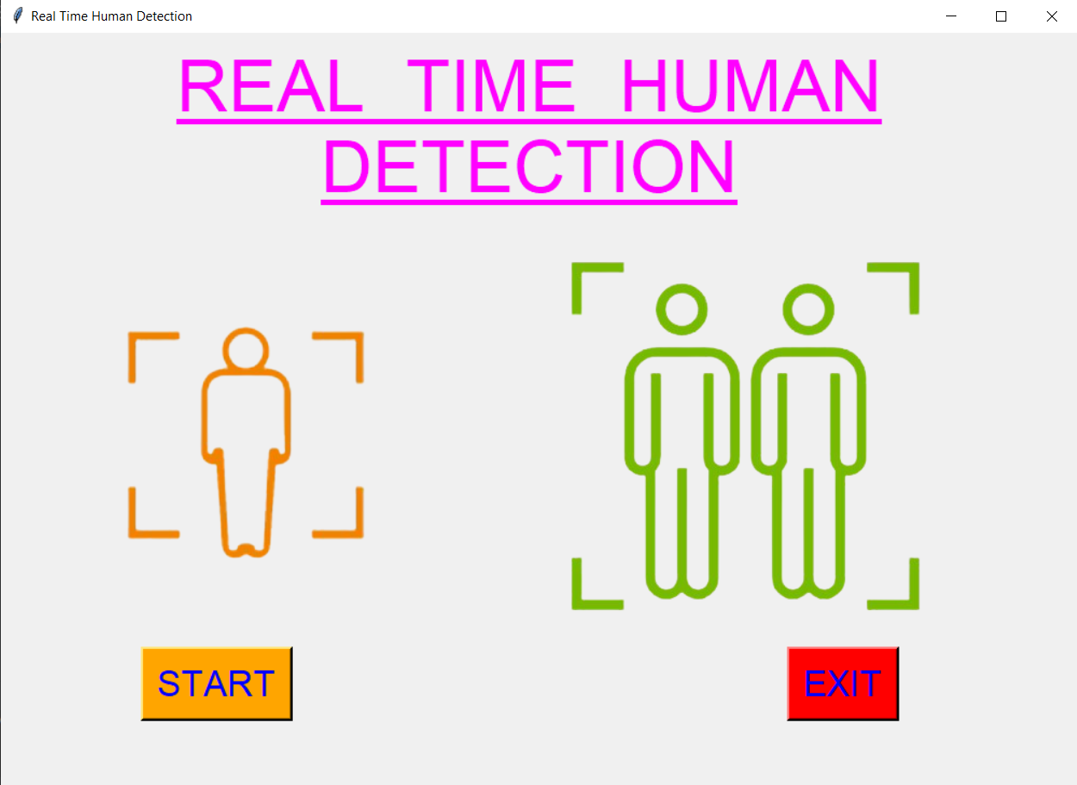
GUI SAMPLE OUTPUT

Slide 9
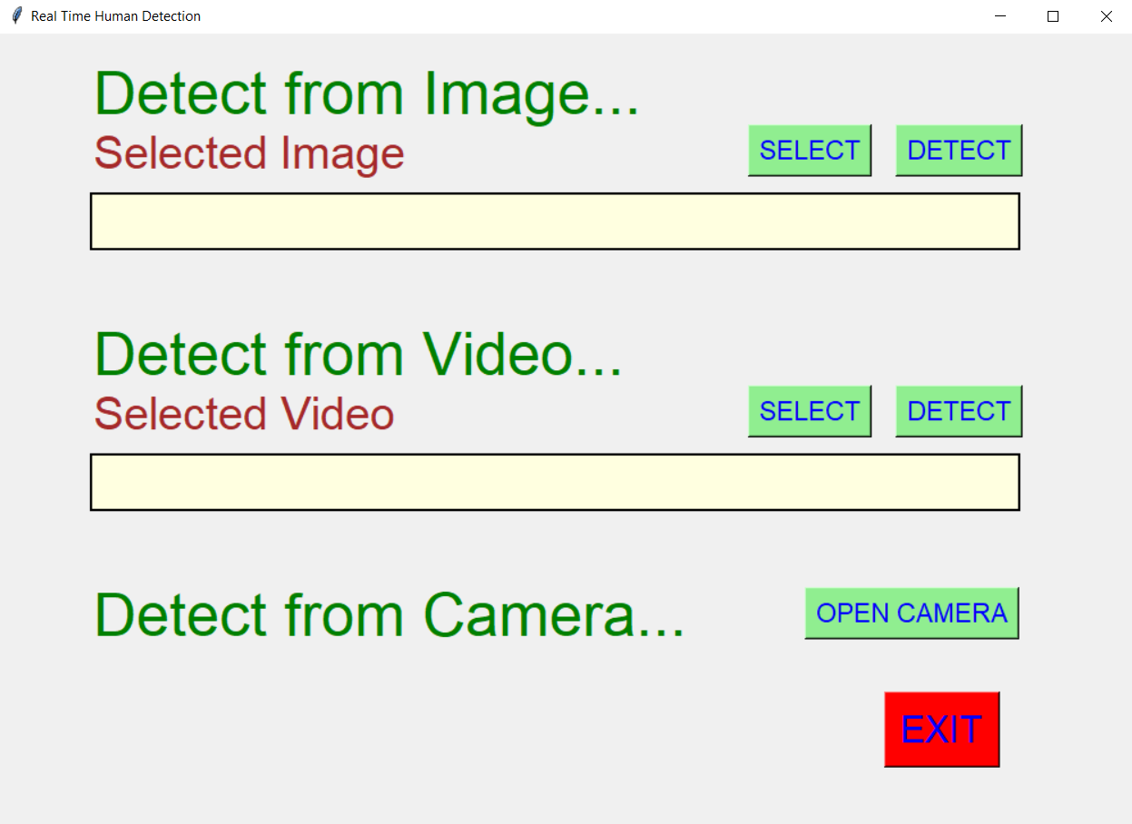
GUI SAMPLE OUTPUT

Slide 10
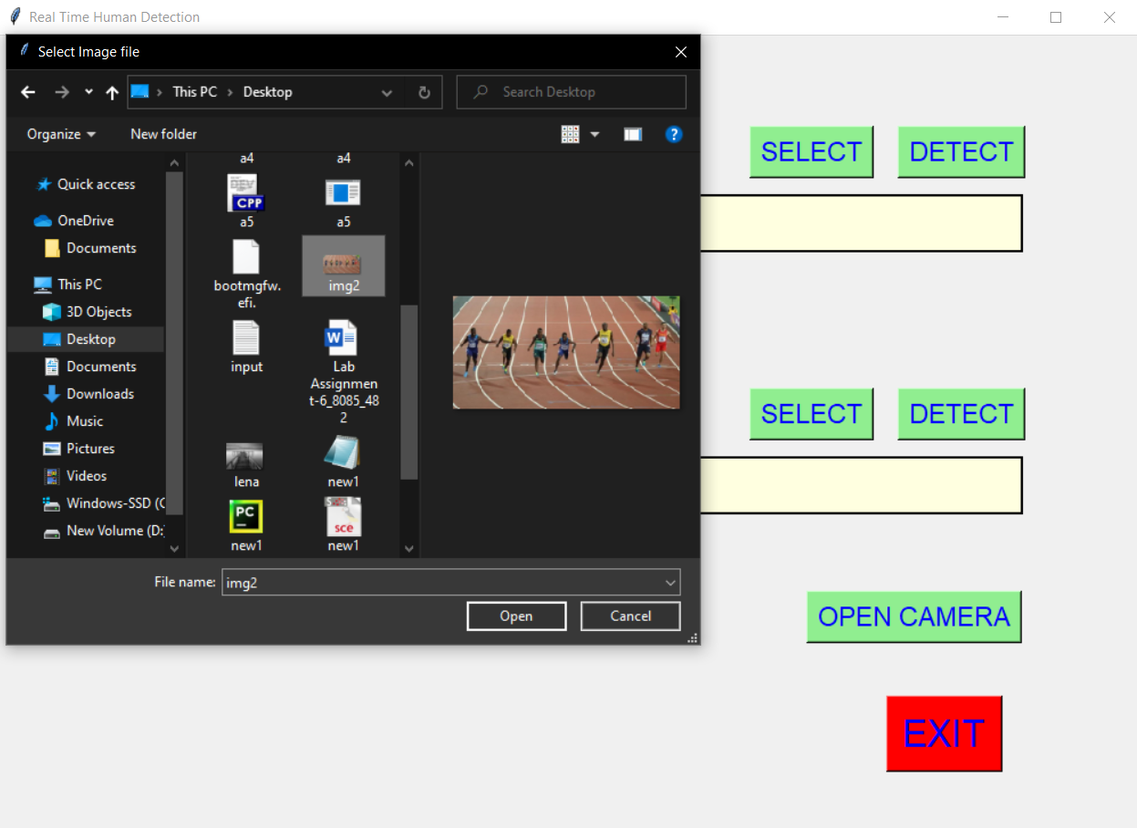
GUI SAMPLE OUTPUT
When we click on select button on image option, we get option to select image from the local system and when click on the detect button, an output image is shown which detected human and their count.

Slide 11
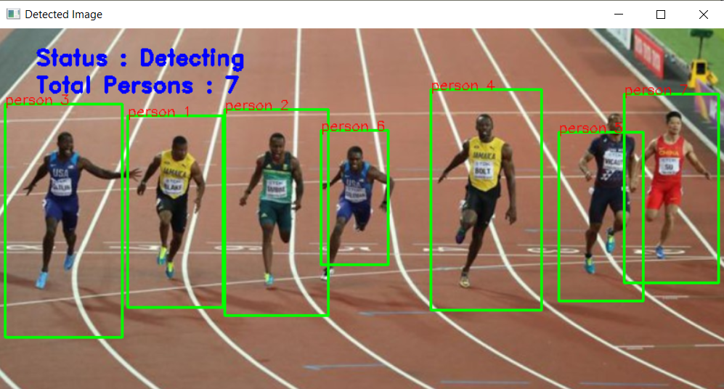
DETECTION IN AN IMAGE
In the same way when we select video from the local system, it will give the output by detecting the humans in the video.

Slide 12
Using TensorFlow and CNN with Deep Learning
This is the for various computer vision problems such as Image Classification , Object Detection and Object Localization.
TensorFlow is an open-source API from Google, which is widely used for solving machine learning tasks that involve Deep Neural Networks.
CNNs were widely adapted third method which we are learning to detect the humans using Deep Learning.
This method gives better accuracy as compared to first two methods, so further we are going to apply this method for detecting and will definitely see some positive result on the accuracy.

Slide 13
Using TensorFlow and CNN with Deep Learning
We implemented the tensorflow method of detecting the human using neural networks.
And we got better accuracy as compared to the 1st method that was Haar Cascade Classifier and the 2nd method that was using HOG descriptor.
Both the earlier method, gave almost the same accuracy and only few humans are only getting detected but with tensorflow method, accuracy increased very much and almost all the humans got detected.
And along with detecting and counting no. of humans, we also got the accuracy of each human with which it is getting detected.

Slide 14
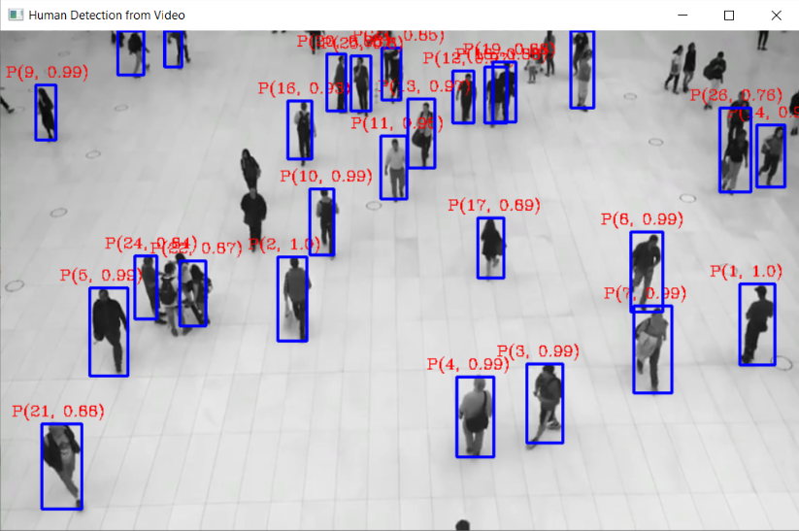
SAMPLE OUTPUT
The sample screenshot accuracy increased with tensorflow is as follows:
Here for each detected human, the first term is count and the second term is the accuracy of detection.

Slide 15
CONCLUSION
Conclusively, the project was a real fun throughout the semester. We have learned a lot in the field of computer vision and object detection techniques.
this can be implemented in the commercial and rushed areas for having an accurate human data and for controlling the crowd.

Slide 16
REFRENCES
[1] Programming Computer Vision with Python, 1st Edition, Jan Eric Solem, 2012, O’ Reily
[2] Learning OpenCv, Adrian Kaehler and Gary Rost Bradski, 2008, O’Reily
[3] Deep Learning with Tensorflow, Giancarlo Zaccone, Md. Rezaul Karim, Ahmed Menshawy, 2017
[4] Python GUI Programming with Tkinter, Alan D. Moore, 2018
[5] Python Standard Library, Fredrik Lundh, 2001, O’ Reily
THANK YOU

